Slide 1

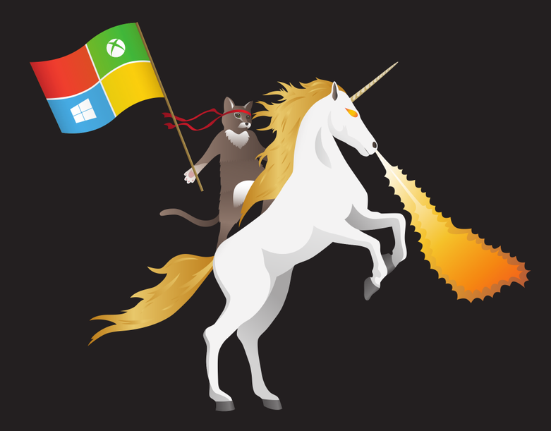
Success on Windows: Developing Universal Windows
Platform apps for mobile
Andrew Moll Microsoft Technical Evangelist Andrew.Moll@microsoft.com
Blog: AndrewSMoll.com
@AskTheData

Slide 2
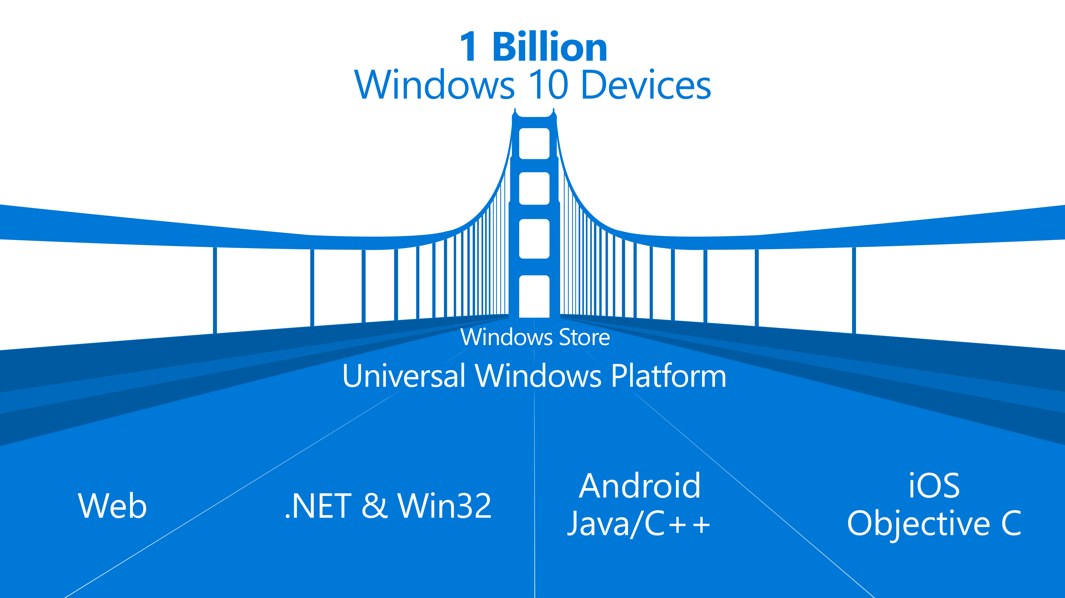

Slide 3

The convergence journey
Xbox 360
Xbox One
Unified core and app platform
Converged
OS kernel
Windows 8.1
Windows 8
Converged
app model
Windows 10
Windows Phone 8.1
Windows Phone 8
Easy for users to get & stay current
Windows Phone 7.5
Windows on Devices
Notes:
OS Kernal allowed for multi core etc. But win 8.1 had similar but not identical across. They were using Silverlight which we still don’t really use
Now nirvana with win 10 which is the truly converged dev platform.

Slide 4

Introducing the UWP

Slide 5
Windows Core
The refactored common core
One hardware platform
Universal hardware driver
Standard network and I/O
Windows App
Desktop SKU
Phone SKU
Xbox SKU
Universal Windows Platform
Windows Core
Desktop
Device
Phone
Device
Xbox
Device
Notes:
Windows core. What we install all over is really just the same version of windows.

Slide 6
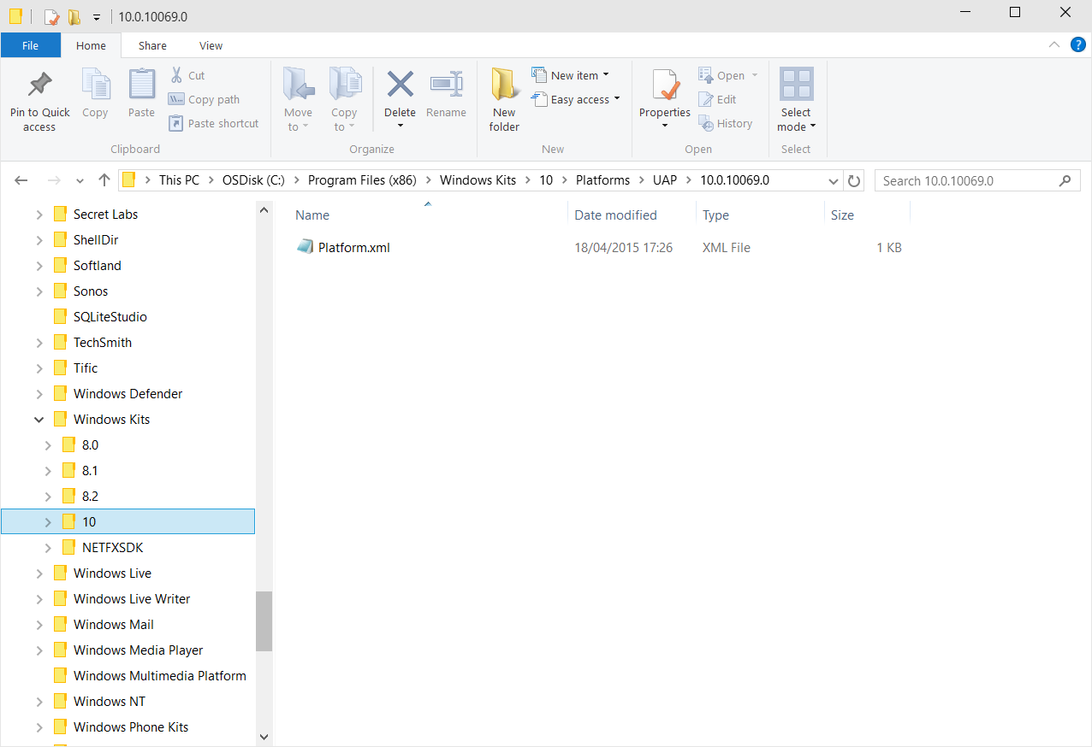
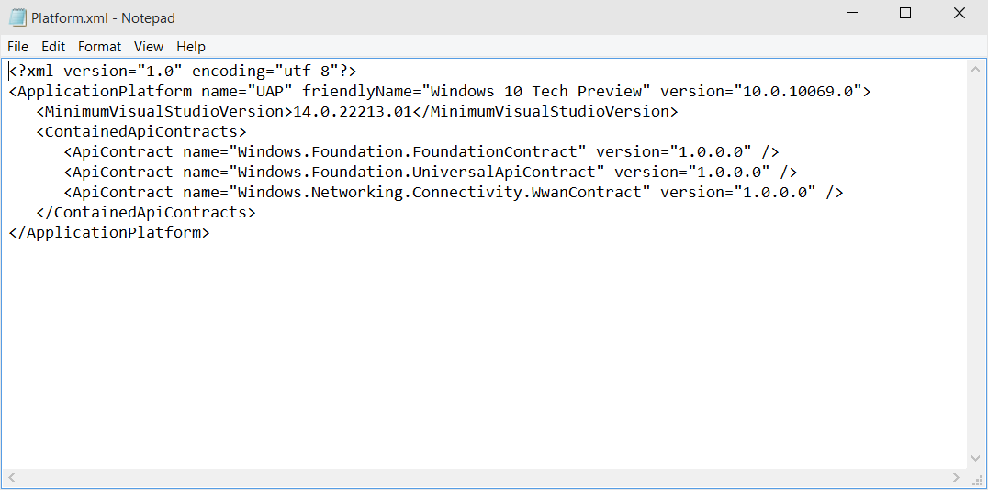
Universal Windows Platform
A single API surface
A guaranteed API surface
The same on all devices
Windows App
Desktop SKU
Phone SKU
Xbox SKU
Universal Windows Platform
Windows Core
Desktop
Device
Phone
Device
Xbox
Device

Slide 7
<TargetPlatform
Name="Microsoft.Universal"
minVersion="10.0.10069.0"
maxVersionTested="10.0.10190.0"/>

Slide 8
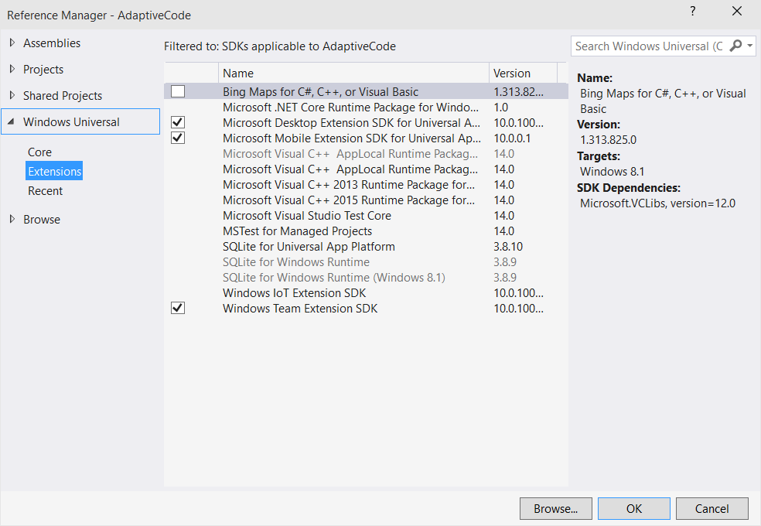
Platform extensions
Device-specific API
Family-specific capabilities
Compatible across devices
Unique update cadence
Windows App
Desktop
extension
Phone
extension
Xbox
extension
Universal Windows Platform
Windows Core
Desktop
Device
Phone
Device
Xbox
Device

Slide 9
One Windows
Desktop SKU
Mobile SKU
Xbox SKU
IoT SKU
IoT headless SKU
Surface Hub SKU
Holographic SKU
PC
2 in 1
Tablet
Phablet
Phone
Xbox
Band
Raspberry Pi
Surface Hub
HoloLens
Home Automation
Notes:
7 different products for now. We have the ability to bring in future products.

Slide 10
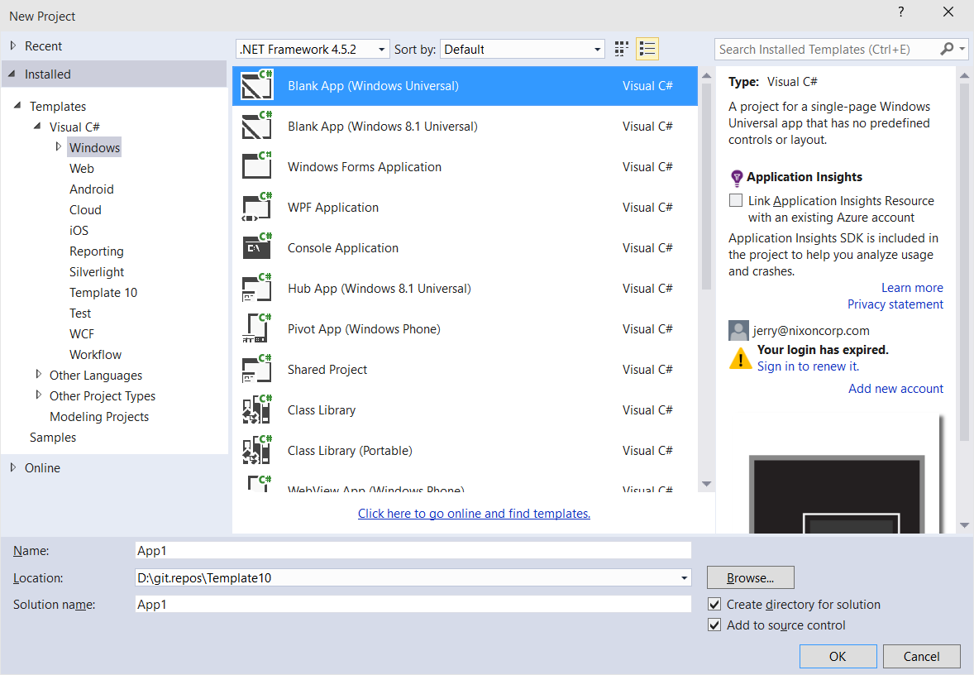
Windows app
A single binary
Running on any device
Testing for capabilities
Adjusting to devices
Windows App
Desktop SKU
Phone SKU
Xbox SKU
Universal Windows Platform
Windows Core
Desktop
Device
Phone
Device
Xbox
Device

Slide 11
Test capabilities at runtime
Use Adaptive Code to light-up your app on specific devices
var api = "Windows.Phone.UI.Input.HardwareButtons";
if (Windows.Foundation.Metadata.ApiInformation.IsTypePresent(api))
{
Windows.Phone.UI.Input.HardwareButtons.CameraPressed += CameraButtonPressed;
}
Notes:
Not a # if statement where if x build y but it’s actually the same app with a single bianary
And so that is the Universal Windows Platform

Slide 12
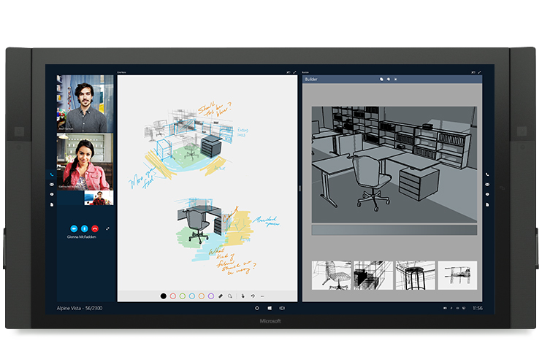
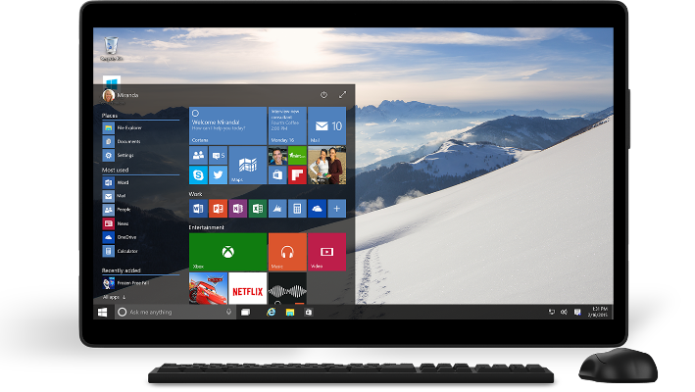
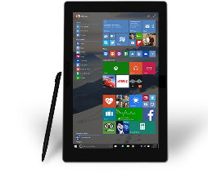
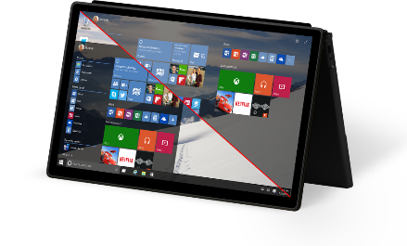
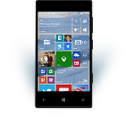
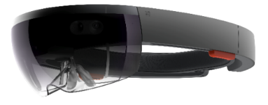
Universal Windows Platform
One Operating System
One Windows core for all devices
One App Platform
Apps run across every family
One Dev Center
Single submission flow and dashboard
One Store
Global reach, local monetization Consumers, Business & Education
Notes:
Dev enters are separate for win 8 and win phone. MSDN has now been converged as well.

Slide 13
Microsoft design language principles
Keep it Simple Isn’t it nice when things just work, when the next step is intuitive, and people are inspired? | Make it Personal We design for real people, not requiring people can fit into our design. Personal means human.
Think Universal Better technology for anyone is better technology for everyone. It’s an attitude. | Create Delight Attention of detail equals moments of delight. Sometimes delight is so perfect it is invisible.
Design as One Work together and do amazing things. Many teams, one ecosystem, happy customers.

Slide 14
For most text, use 15 epx Segoe UI Regular

Slide 15
Physical versus effective pixel
4” Phone
480x854
4” Phone
480x854
5” Phone
720x1280
5” Phone
720x1280
6” Phone
1080x1920
6” Phone
1080x1920

Slide 16
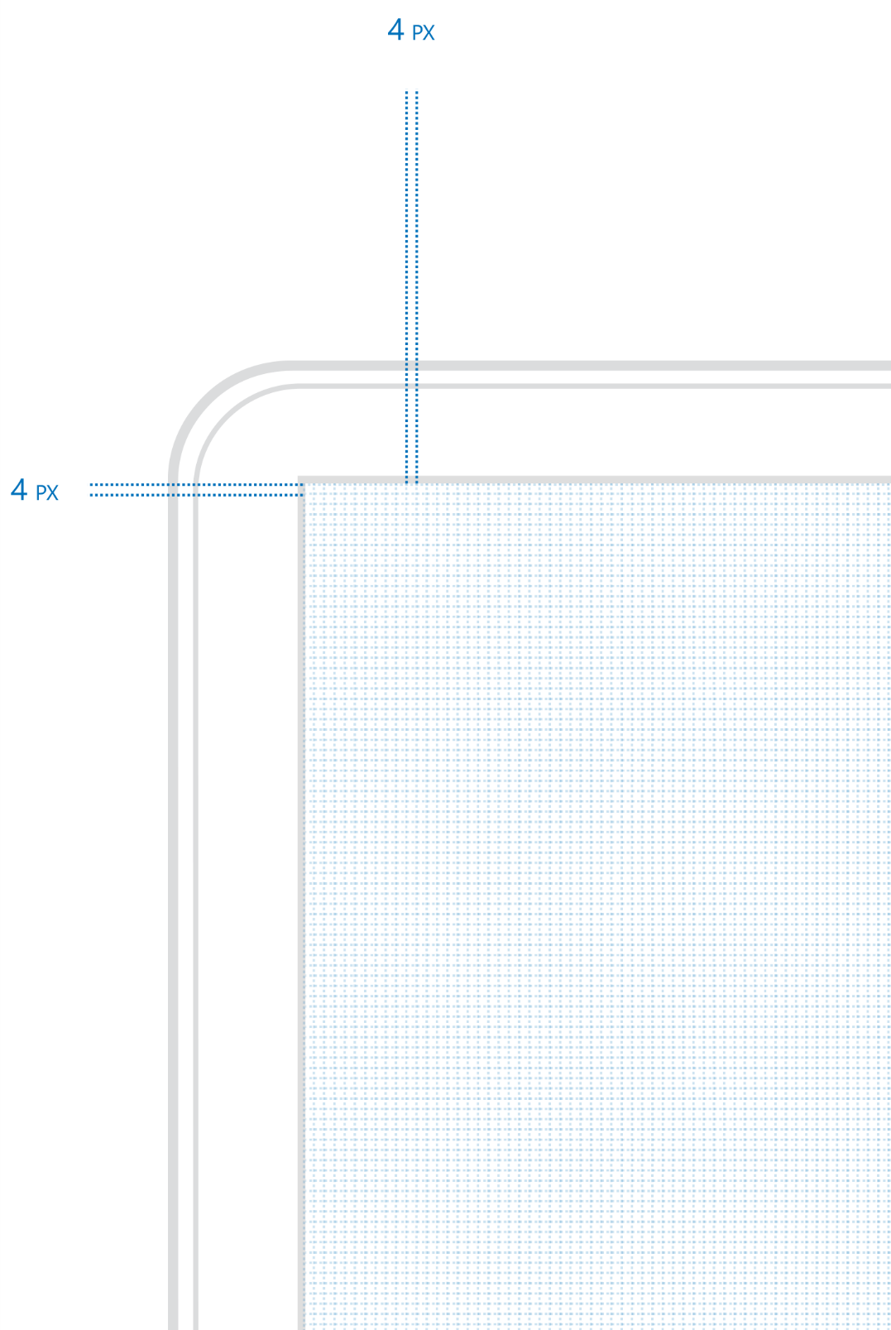
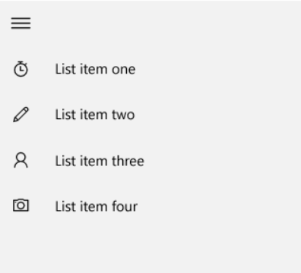
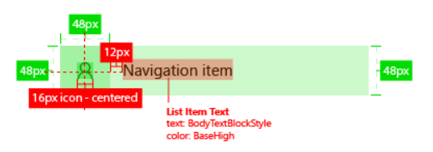
Four is the magic number

Slide 17
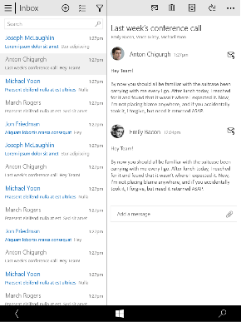

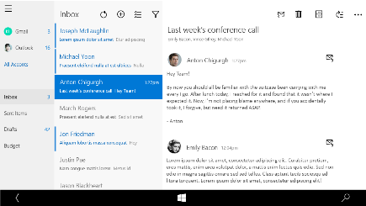
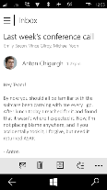
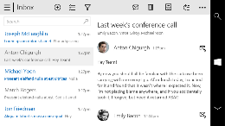
Snap points
epx
320
548
720
1024
phone
phablet & tablet
desktop
limited landscape support
one frame at a time
sys tray on the left
steering wheel on the right
4+ actions on the bottom
tabs are centered
limited landscape support
one frame at a time
sys tray on the left
steering wheel on the right
4+ actions on the bottom
single column stops scaling
tabs are centered
full landscape support
two frames
actions at the top
one “…” visible - TBD
tabs are left aligned
Show search field if search was represented as an icon on smaller devices
full landscape support
three frames
compact nav pane
actions at the top
one “…” visible
tabs left aligned

Slide 18
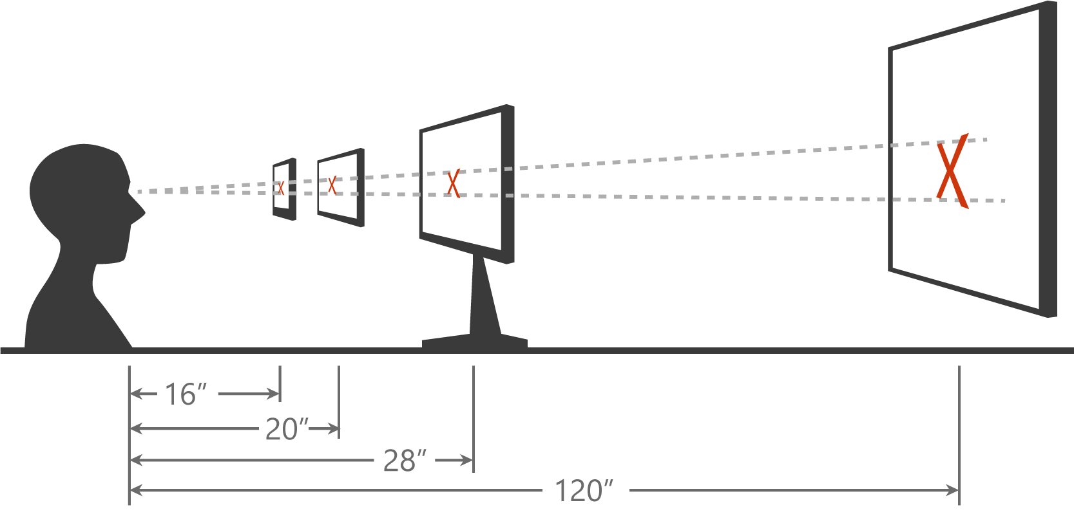
Scaling algorithm

Slide 19
As you design
Adapt to size change
Adapt to input change
Build with effective pixels
Count on the scaling algorithm

Slide 20
Techniques to adapt

Slide 21
Adaptive design
Responsive design
Flexible layout responds to small changes
Many controls handle basic responsiveness
Adaptive design
Smart layout adjusts to large changes
Features like visual states aid in this design
Tailored design
A device-specific app can simplify design
Some devices have unique design languages
Notes:
Responsive design: use % not pixels

Slide 22
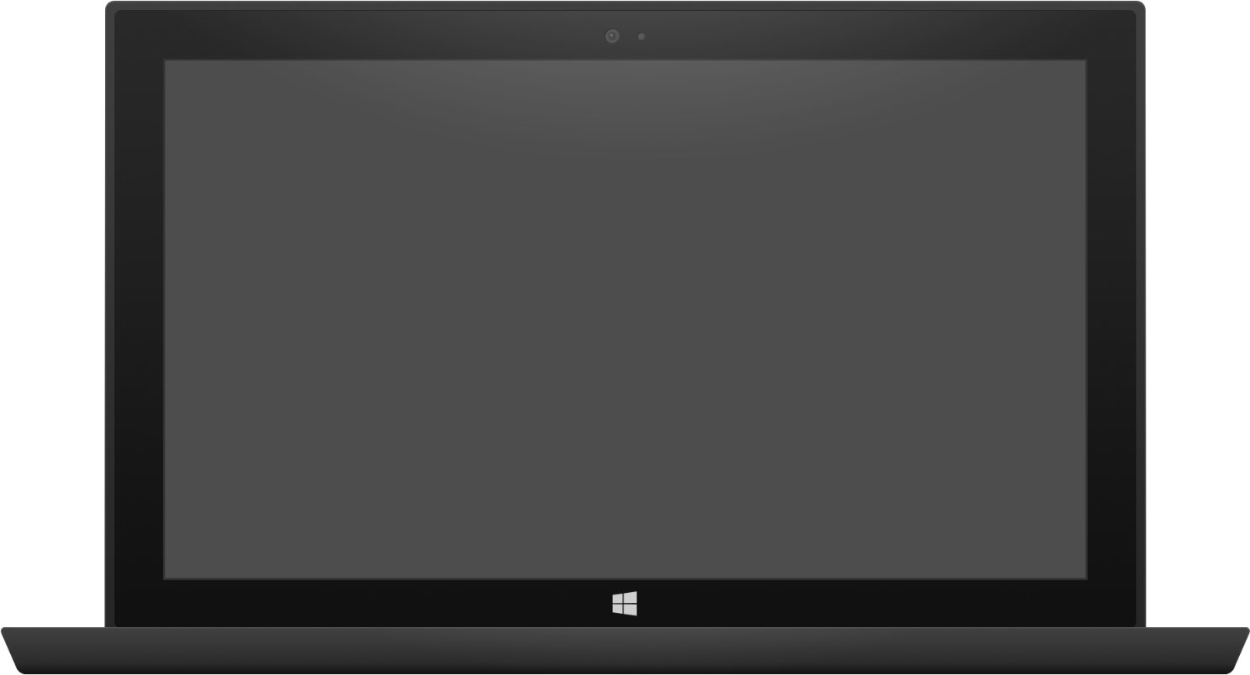

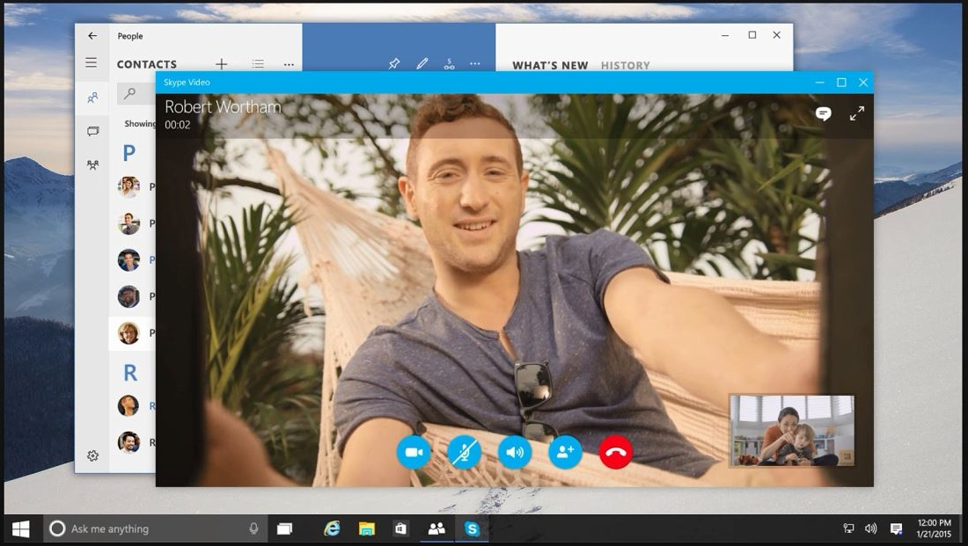
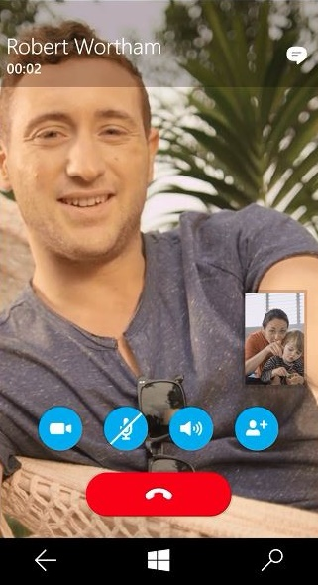
Adaptive design
Tablet (landscape) / Desktop
Phone (portrait)

Slide 23
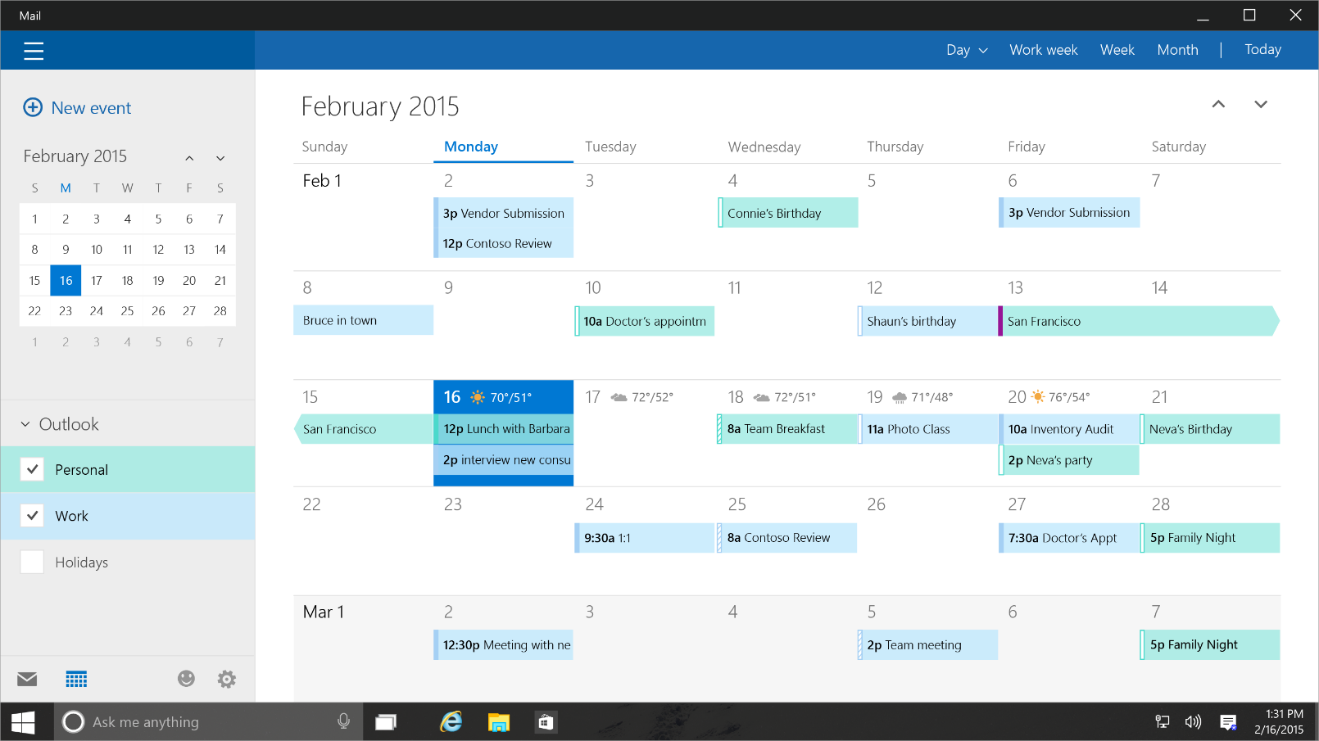
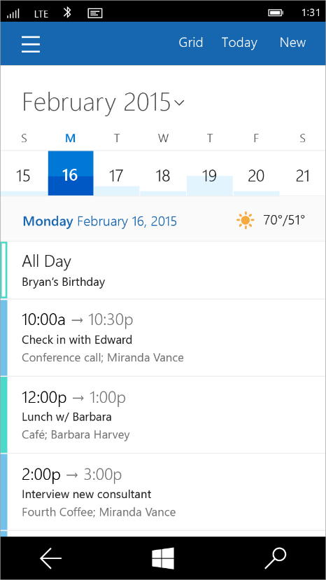
Tailored design
Tablet (landscape) / Desktop
Phone (portrait)

Slide 24
UI Layouts and Controls

Slide 25

Layout controls
<Border Thickness="" Brush="" />
<Canvas />
<Grid />
<RelativePanel />
<ScrollViewer />
<SplitView DisplayMode="" />
<StackPanel Orientation="" />
<VariableSizedWrapGrid />
<ViewBox Stretch="" />

Slide 26
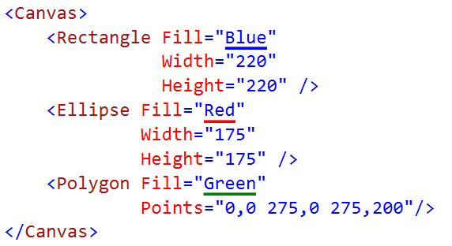

Canvas

Slide 27

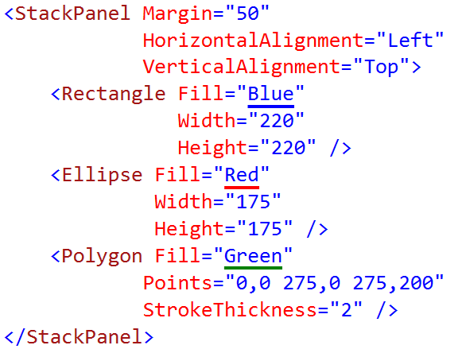
StackPanel

Slide 28
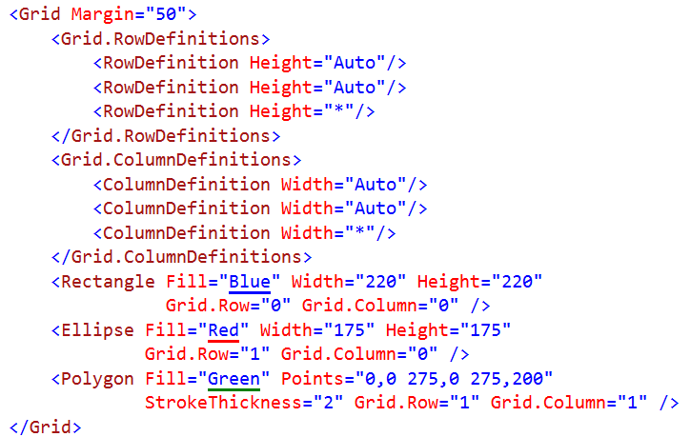
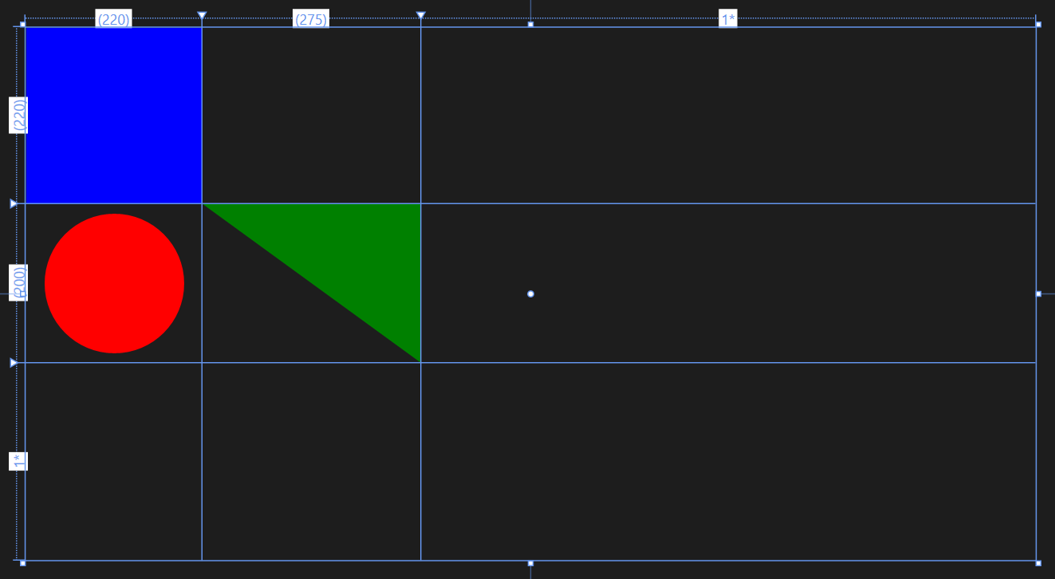
Grid
Notes:
3 rows and 3 columns
* Is to take the rest of the space available.

Slide 29
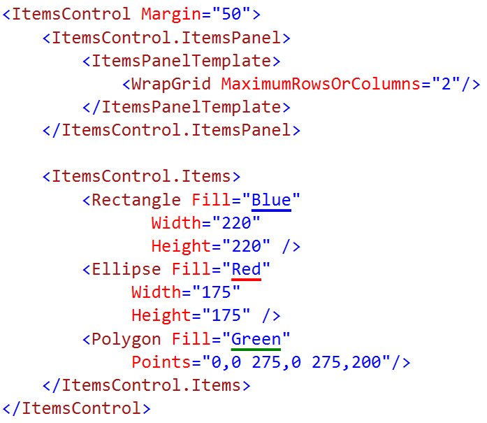
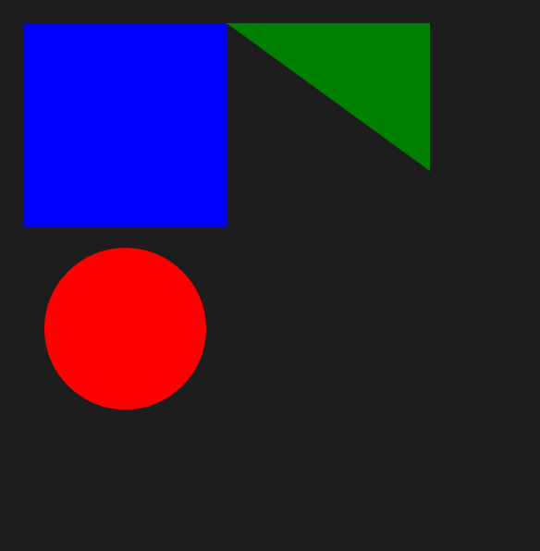
WrapGrid
Notes:
Each cell is defined by the first item put in. Can only really do this in a repeater control

Slide 30
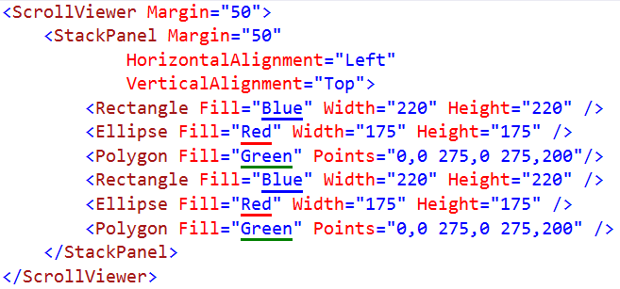
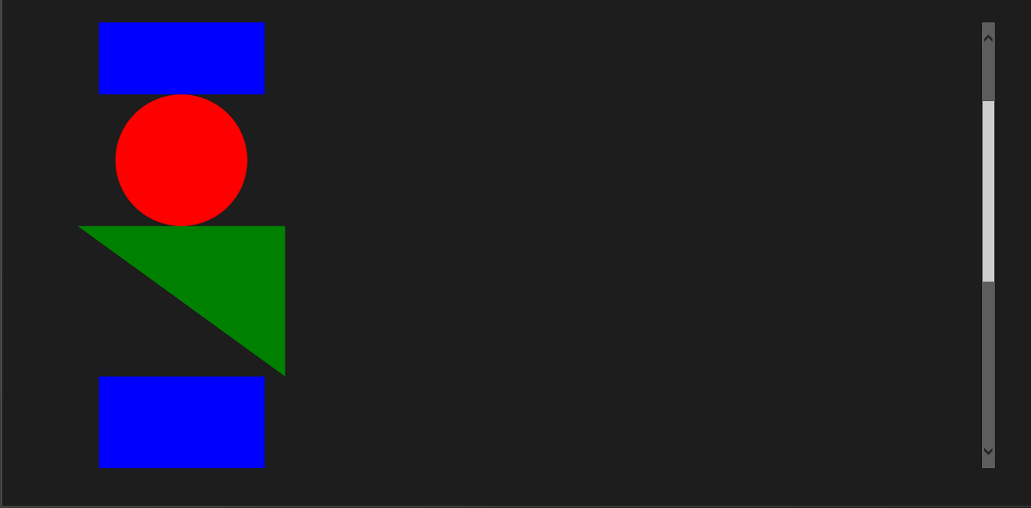
ScrollViewer
Notes:
This is jut a scroll bar

Slide 31
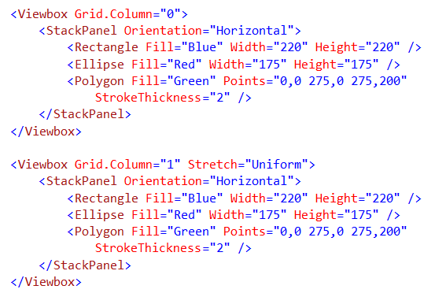
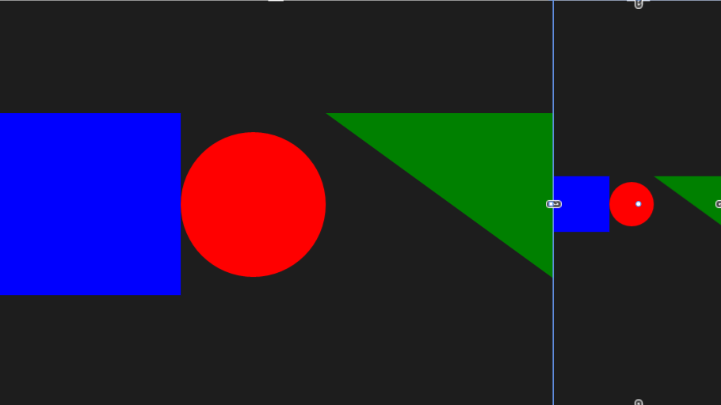
Viewbox
Notes:
View Box sizes things into the box.

Slide 32

RelativePanel
Some child elements act as anchors
Most child elements relate to others
It's a layout technique friendly with States
Notes:
Things are anchored to a specific panel. The old way would have been messing with different grids and moving it to empty cells. Messy

Slide 33
SplitView
 | IsPaneOpen="True" | IsPaneOpen="False"
DisplayMode= "Inline"
DisplayMode= "Overlay"
DisplayMode= "CompactInline"
DisplayMode= "CompactOverlay"

Slide 34
State Triggers
5 in Phone
4 in Phone

Slide 35
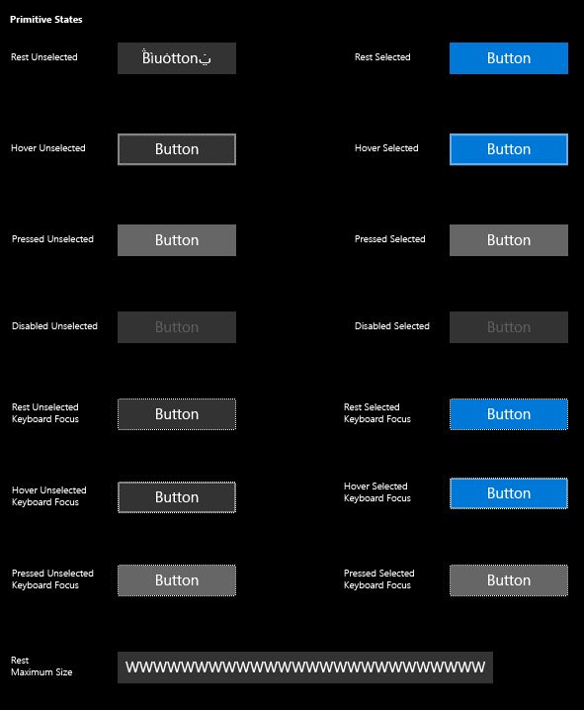
Buttons
<Button Content="" />
<HyperlinkButton />
<RepeatButton />
<ToggleButton IsChecked="" />

Slide 36
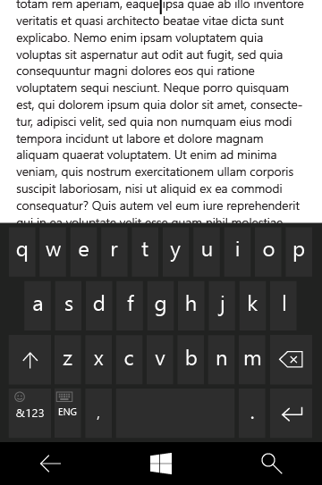
Text controls
<TextBox Text="" />
<PasswordBox Text="" />
<TextBlock Text="" />
<RichEditBox Content="" />
<RichTextBlock Content="" />
<BitmapIcon UriSource="" />
<FontIcon Glyph="" />
<SymbolIcon Icon="" />
<PathIcon Data="" />

Slide 37
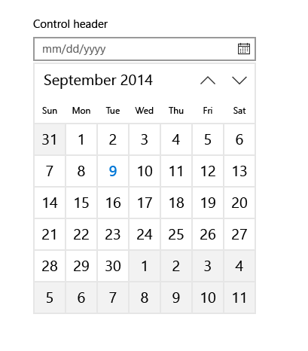
Selection and picker controls
<CalendarView />
<DatePicker Date="" />
<TimePicker Time="" />
<ToggleSwitch IsChecked="" />
<CheckBox IsCHecked="" />
<RadioButton IsChecked="" />
<ComboBox />
<ListBox />
<Slider Minimum="" Maximum="" />

Slide 38
Adaptive UI

Slide 39
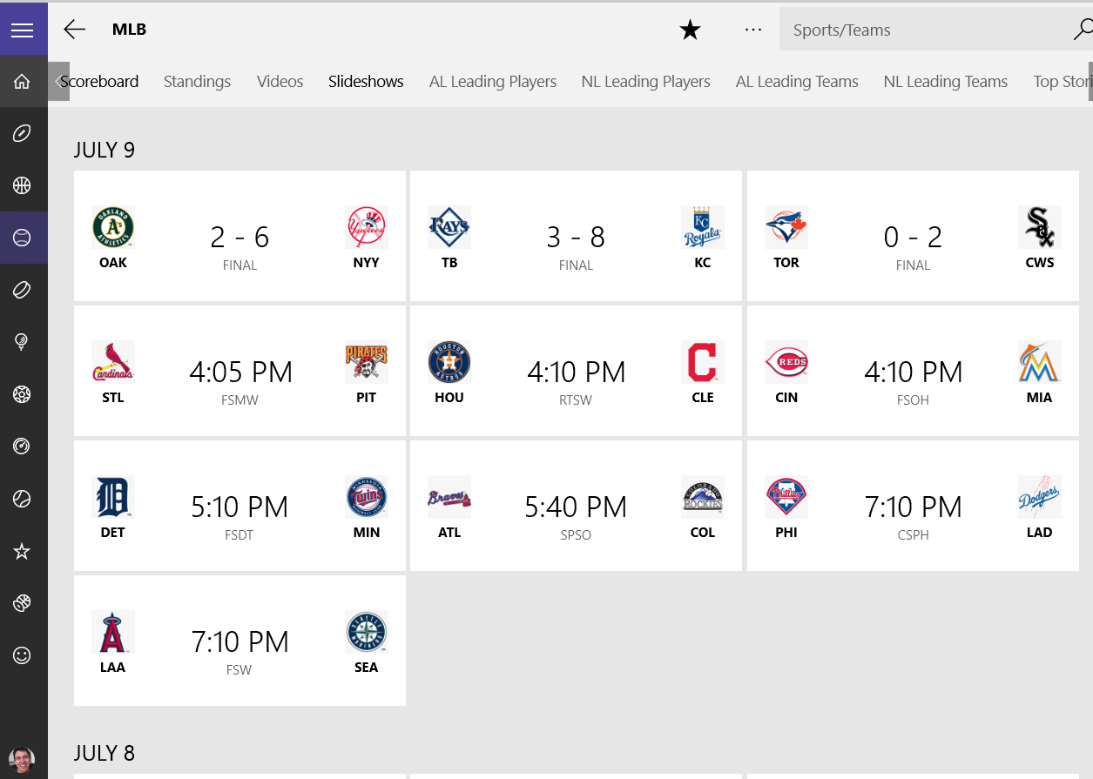
Notes:
Tab control/pivot? Probably navigation buttons in a stack panel
Individual stack panel
List of

Slide 40
Using standard controls gets you a long way

Slide 41
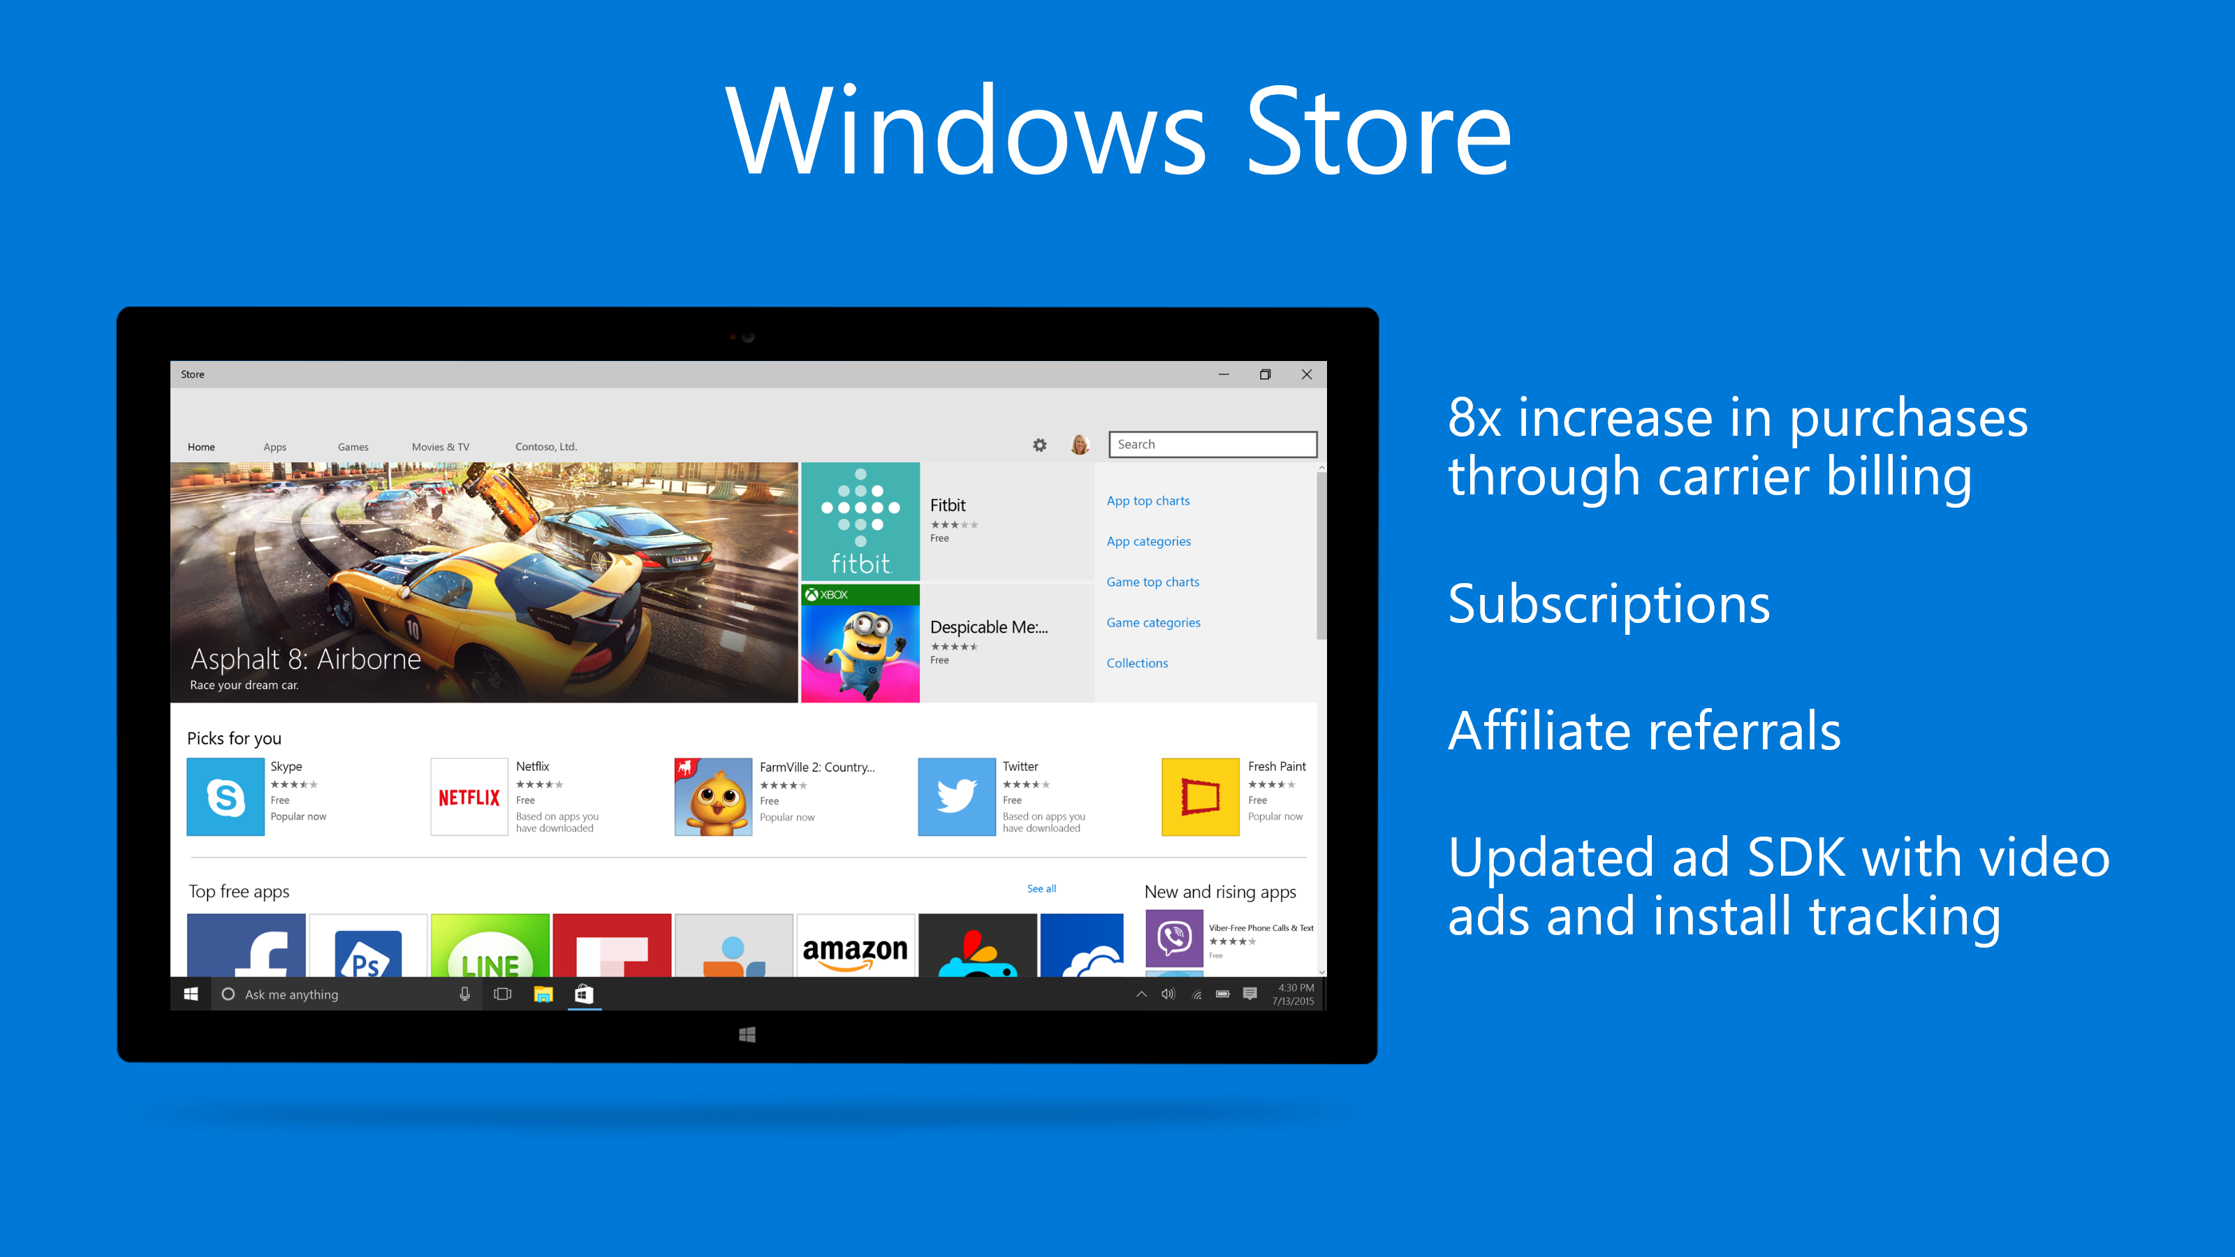
Notes:
Subscriptions: Ability to add subscription based apps
Affiliate: You can sell everything on your blogs and push those through the windows store
Mobile purchasing option. One store for everything!
Ability to do house ads! Can do ads on your dev blog for your applications

Slide 42
Universal Windows Platform
Wherever your code was born, you can bring it to Windows
Other Mobile Platforms
Project Astoria
Use your Java / C++ code
Use Android IDE
High code reuse
Project Islandwood
Use your Objective C code
Use Visual Studio
Medium-high code reuse

Slide 43
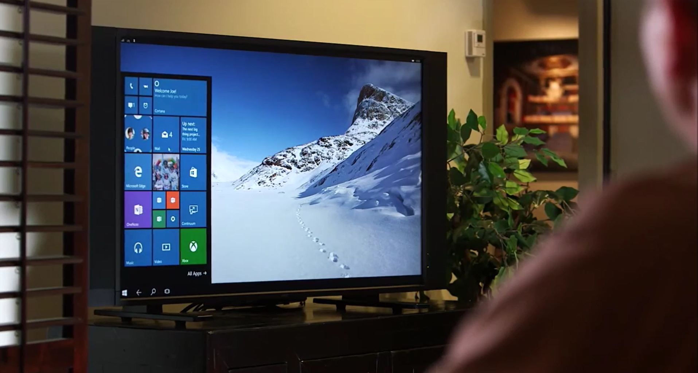
Continuum for Convertibles and Phones
Continuum for convertibles and Phones

Slide 44
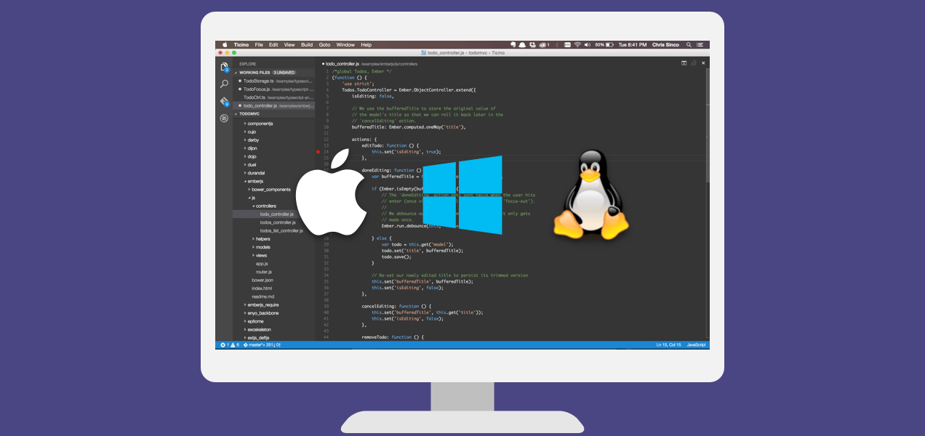
Visual Studio Code
Build and debug modern web and cloud applications.
Code is free and available on your favorite platform:
Linux, Mac OSX, and Windows.
C#, TypeScript, JavaScript, HTML, CSS, LESS, SASS, Python, JSON, CoffeeScript, Ruby, Jade, Clojure, Java, C++, R, Go, makefile, shell, powershell, bat, XML, Markdown
http://code.visualstudio.com

Slide 45


Online Microsoft training delivered by experts to help technologists continually learn
Hundreds of courses for developers, IT Pros, students, entrepreneurs and enthusiasts
11 different languages
3M students registered
Build your own Learning Plan
All free!
http://www.microsoftvirtualacademy.com

Slide 46
Technical Resources for Windows Devs
Visual Studio Community Edition (free): http://aka.ms/vsc2013
Ultimate Guide & FAQ to Setting-up a Windows Phone Dev Environment: http://aka.ms/wpdevsetup
Building Apps for Windows Blog: http://blogs.windows.com/buildingapps
Dvlup Challenges & Rewards: www.dvlup.com
Microsoft App Studio: http://appstudio.windows.com
Nick Landry’s Blog: www.AgeofMobility.com
Windows Phone Developer Magazine (online): http://flip.it/95YFG
Windows Phone 8.1 Jump Start Training: http://aka.ms/wp81js
Windows 8.1 Universal Apps Samples Pack https://code.msdn.microsoft.com/windowsapps/Universal-Windows-app-cb3248c3

Slide 47

Thank You!
Contact me and let me know what you build, I will be happy to help promote your projects.
Blog: www.AndrewSMoll.com
Twitter: @AskTheData
Email: Andrew.Moll@microsoft.com
LinkedIn: www.linkedin.com/in/andrewmoll
GitHub: github.com/AndrewMoll

